Slide 1
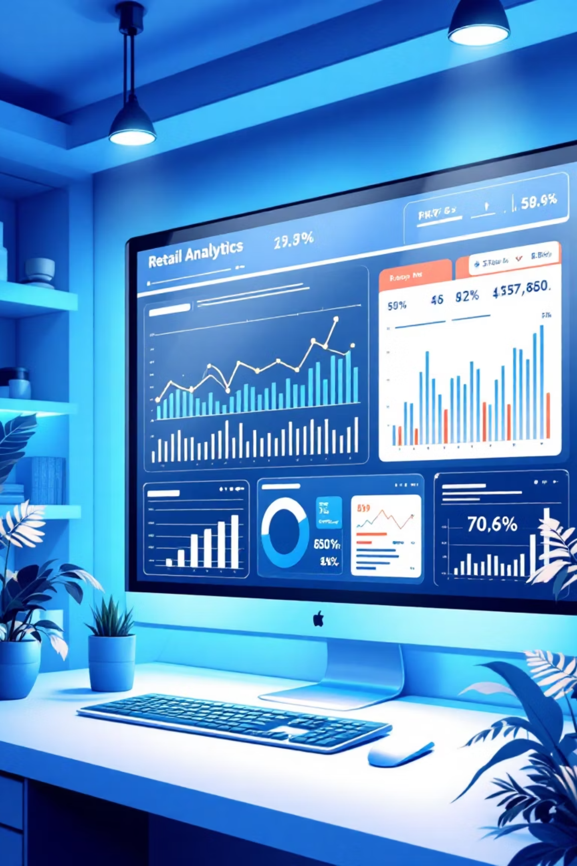
Customer Shopping Behavior Analysis
Analyzing 3,900 purchases to uncover insights into spending patterns, customer segments, and product preferences that drive strategic business decisions.

Slide 2
Dataset Overview
3,900
18
50
25
Total Purchases
Data Columns
Locations
Product Types
Transactions analyzed across all categories
Features covering demographics and behavior
Geographic distribution of customers
Diverse items across four categories
Key features include customer demographics (age, gender, location, subscription status), purchase details (item, category, amount, season, size, color), and shopping behavior (discounts, promo codes, previous purchases, review ratings, shipping type).

Slide 3

Data Preparation in Python
Data Cleaning
Feature Engineering
Loaded dataset using pandas
Created age_group column by binning customer ages
Explored structure with df.info() and .describe()
Generated purchase_frequency_days from purchase data
Imputed 37 missing Review Rating values using median by category
Verified and dropped redundant promo_code_used column
Standardized columns to snake_case
Connected to PostgreSQL for SQL analysis

Slide 4
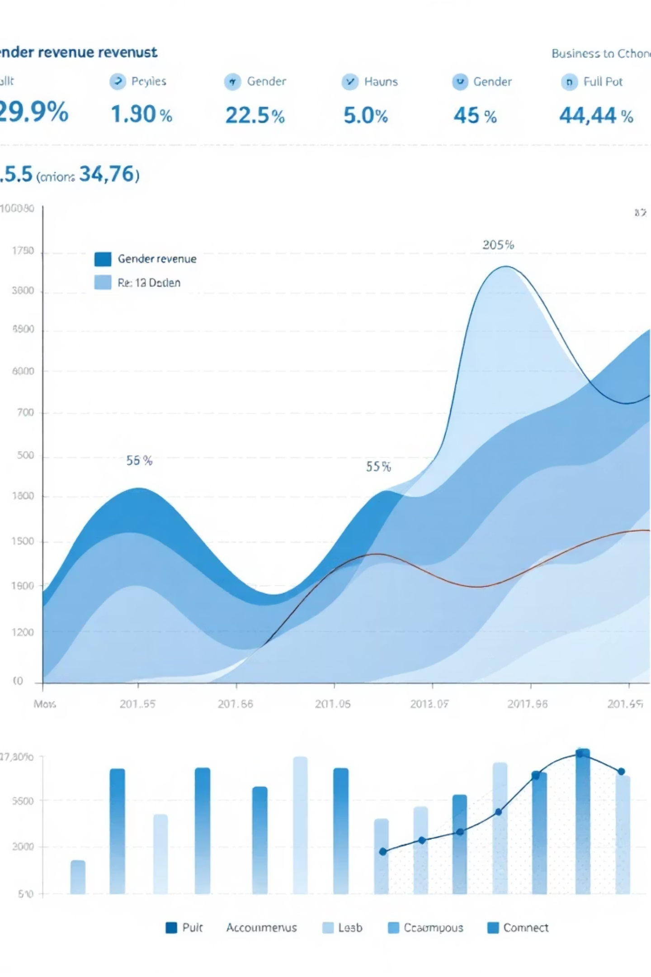
Revenue Insights by Gender
Male Customers
$157,890 total revenue
Representing 68% of total sales
Female Customers
$75,191 total revenue
Representing 32% of total sales
Male customers generate more than double the revenue of female customers, suggesting opportunities for targeted marketing campaigns to balance customer engagement.

Slide 5



Discount Strategy Analysis
839
50%
43%
High-Spending Discount Users
Hat Discount Rate
Discount Adoption
Customers who used discounts but spent above average purchase amount
Highest percentage of discounted purchases
Of all customers applied discounts to purchases
Top discount-dependent products: Hat (50%), Sneakers (49.66%), Coat (49.07%), Sweater (48.17%), and Pants (47.37%). Balance promotional strategy to maintain margins while driving sales.

Slide 6
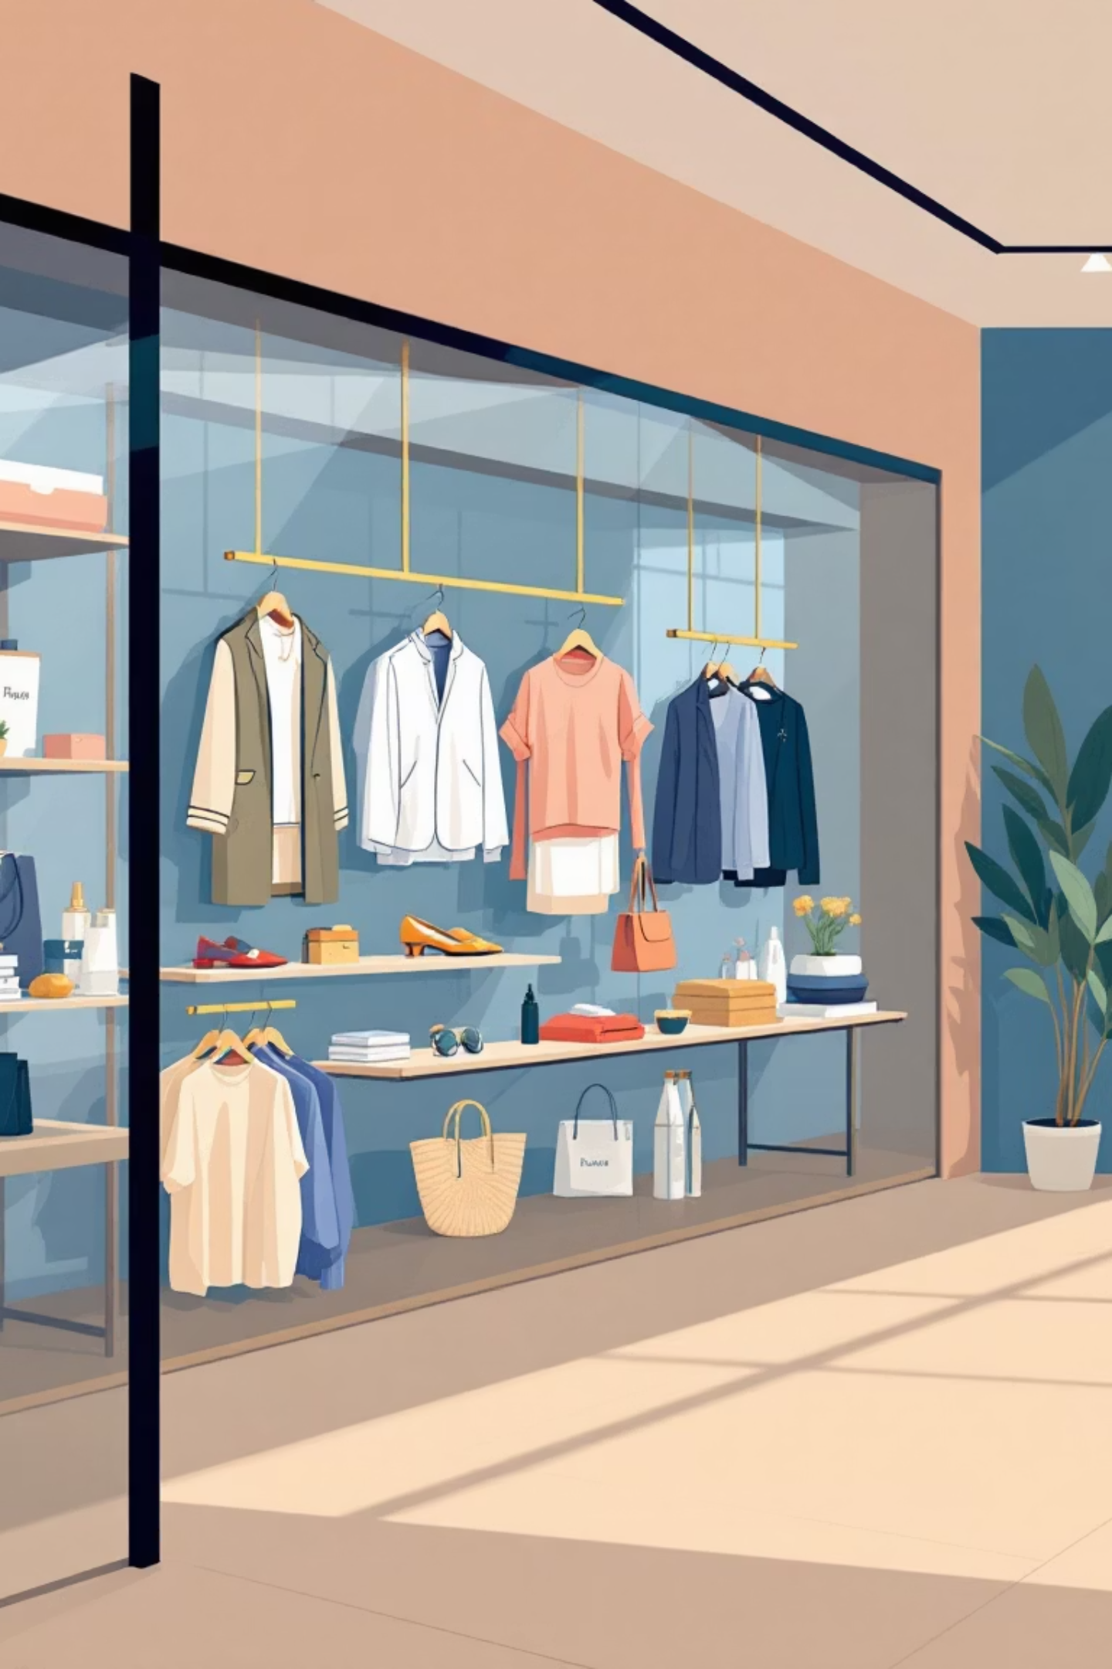
Product Performance Leaders
Top Rated
Clothing Leaders
Accessories & More
Gloves (3.86)
Blouse (171 orders)
Sandals (3.84)
Jewelry leads accessories with 171 orders
Boots (3.82)
Pants (171 orders)
Hat (3.80)
Skirt (3.78)
Shirt (169 orders)
Sandals top footwear with 160 orders
Jacket dominates outerwear with 163 orders

Slide 7



Customer Segmentation
Loyal Customers
1
3,116 customers (80%)
Returning Customers
2
701 customers (18%)
New Customers
3
83 customers (2%)
Strong loyal customer base indicates successful retention. Focus on converting returning customers to loyal status and improving new customer acquisition strategies.

Slide 8
Subscription & Shipping Analysis
Subscription Status
Shipping Preferences
Repeat Buyer Insight
Non-subscribers: 2,847 customers, $59.87 avg spend, $170,436 total revenue
Express: $60.48 average purchase
Of customers with 5+ purchases: 2,518 are non-subscribers, 958 are subscribers
Standard: $58.46 average purchase
Express shipping users spend slightly more per transaction
Subscribers: 1,053 customers, $59.49 avg spend, $62,645 total revenue
Opportunity to convert loyal non-subscribers

Slide 9
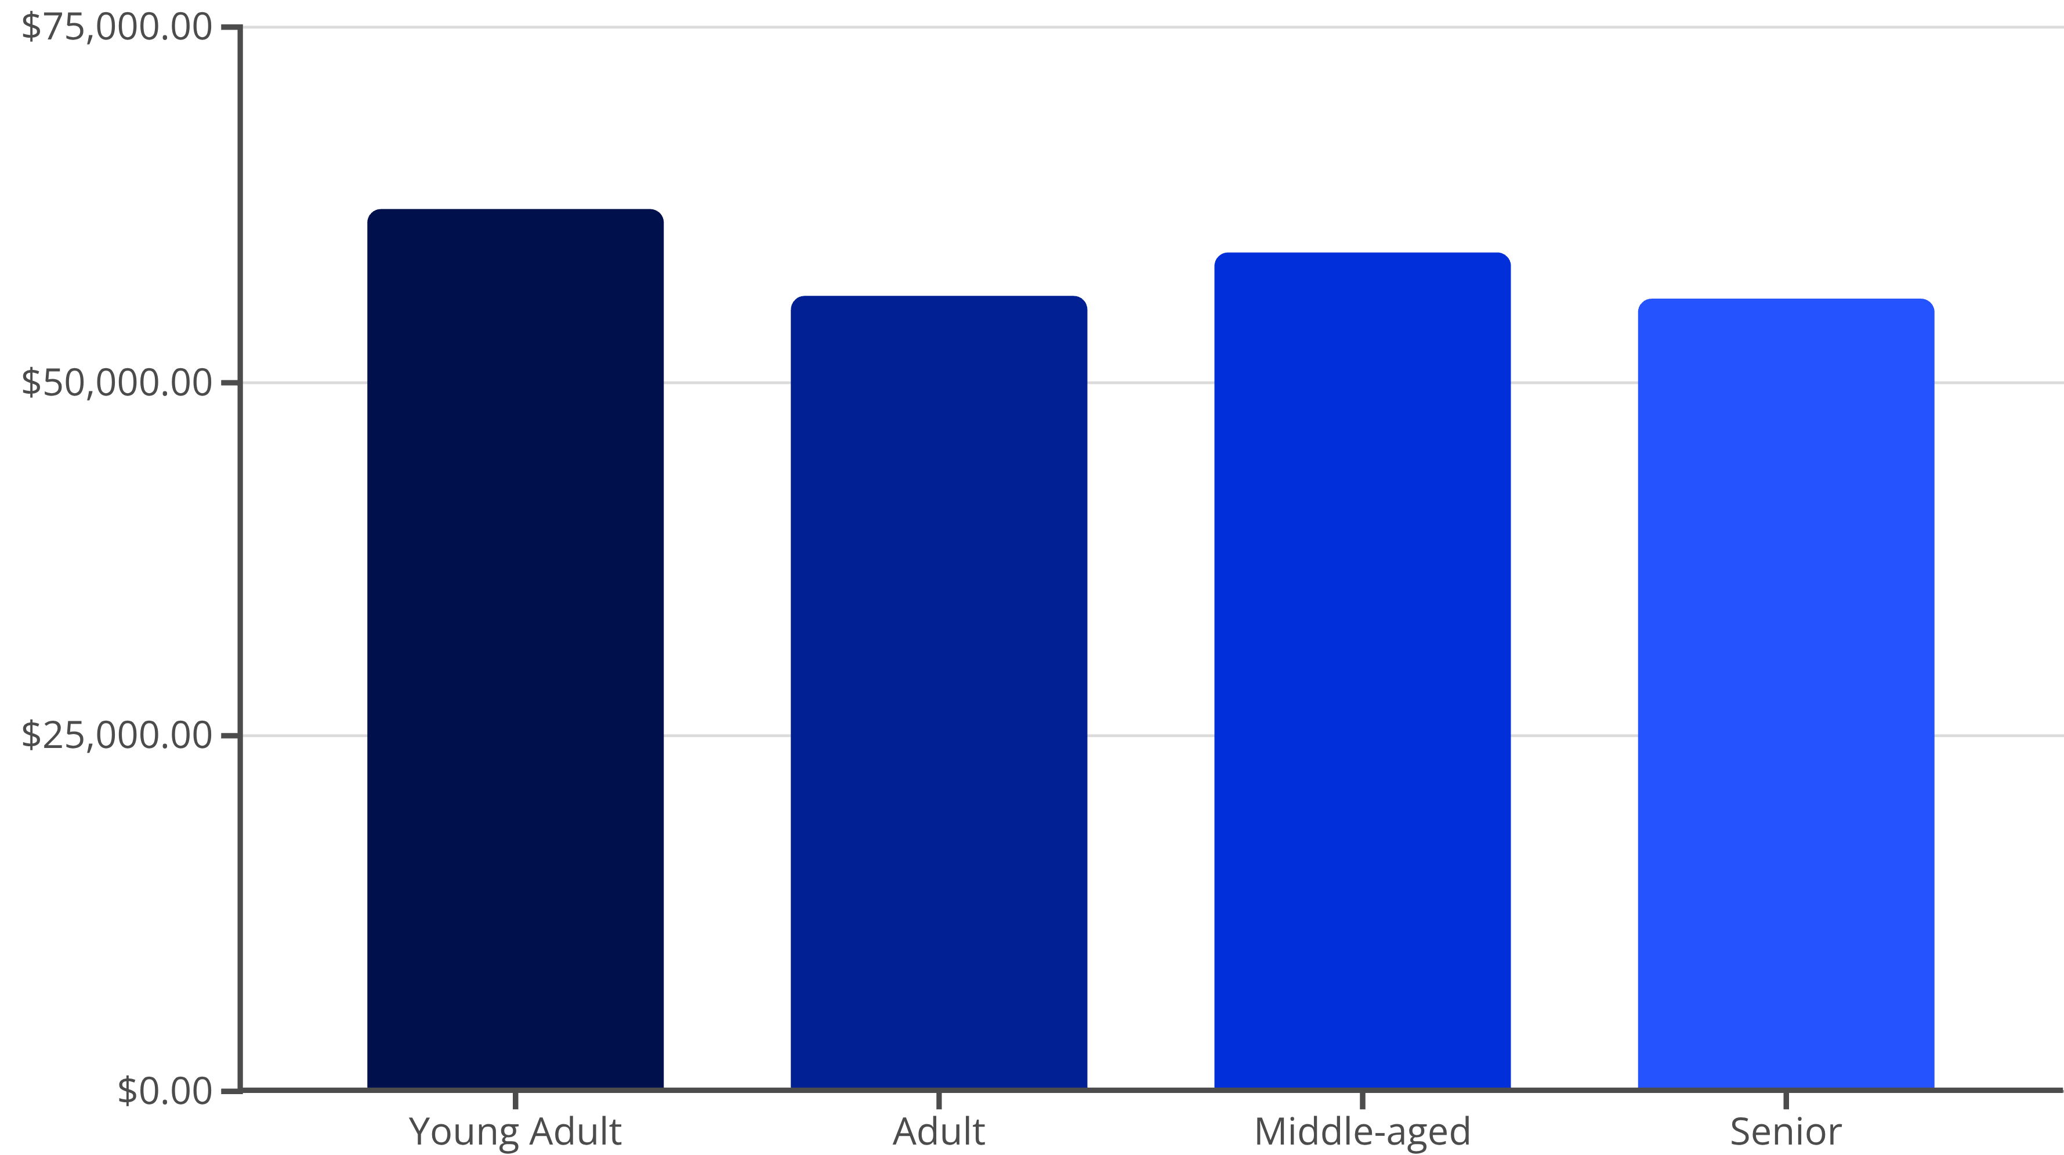
Revenue by Age Demographics
Young adults generate the highest revenue at $62,143, followed closely by middle-aged customers at $59,197. Revenue distribution is relatively balanced across age groups, suggesting broad market appeal.

Slide 10

Strategic Recommendations
Boost Subscriptions
Loyalty Programs
Review Discount Policy
Promote exclusive benefits to convert loyal non-subscribers into subscription members
Reward repeat buyers to accelerate movement into loyal customer segment
Balance promotional sales boosts with margin control and profitability
Product Positioning
Targeted Marketing
Highlight top-rated and best-selling products in marketing campaigns
Focus efforts on high-revenue age groups and express-shipping users

